Slide 1
EYFS & KS1
Knowledge Organisers
Spring Term 2 2023

Slide 2
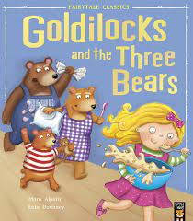
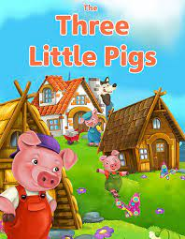
Literacy
World Book Day. Retelling stories. Royal Ball celebration. Key texts: Goldilocks and the Three Bears, The Three Little Pigs.
Understanding the World
Fire engine visit. Observing seasonal change in Forest Schools. Belonging to a community.
Maths
Subitising , addition, doubling and halving. Repeated patterns. Numbers to 10.
EYFS
Spring 2 2023
Happily Ever After
PSED
Turn taking and sharing. Cooperative play. Model building as part of a group. Belonging to a community. Thinking about our families.
Physical Development
Outdoor play and Forest Schools - skipping , running, jumping, dancing, hopping, climbing. Making fairy tale characters using scissors and glue.
Communication and Language
Library visit Reading fairy tales and discussing the characters. Answering questions about the story. Asking questions for a Fire Engine visit. Vocabulary: Fairytale, Once Upon a Time, fiction, character, setting, event, author, illustrator.
Expressive Art and Design
Exploring colour and painting Singing nursery rhymes. Charanga- Singing and playing instruments. Making models of the Three Little Pigs houses.

Slide 3
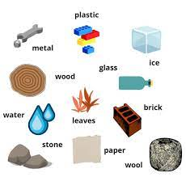
PE
What skills can we use in team games?
Science
Identify, describe and compare different materials.
DT
Design, make and evaluate a model.
Year 1
Spring 2 2023
Happily Ever After
Computing
Changing digital content.
RE
What are sacred books?
Art
Create a piece of artwork using colour.
Key Text:
The Three Little Pigs
PSHE
Belonging to a group in the community Making safe choices online

Slide 4
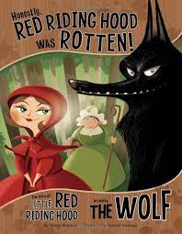
PE
What skills can we use in team games?
Science
Identify, describe and compare suitability of different materials. Discover how shapes of solid objects made from some materials can be changed.
Year 2
Spring 2 2023
Happily Ever After
RE
What are sacred books?
Computing
Changing digital content.
DT
Design, make and evaluate a model with a moving function.
Art
Create a piece of artwork using colour.
PSHE
Belonging to a group in the community. Making safe choices online.
Key Texts: The Three Little Pigs
Honestly, Red Riding Hood was Rotten

